Slide 1
E-COMMERCE (ECM-133)
BIT (Third Semester) – Texas College

Slide 2
UNIT I FUNDAMENTALS OF E-COMMERCE
CHAPTER 1
INTRODUCTION TO E-COMMERCE
DIFFERENCE BETWEEN E-COMMERCE and E-BUSINESS
FEATURES OF E-COMMERCE TECHNOLOGY
BUSINESS SIGNIFICANCE OF E-COMMERCE FEATURES
TYPES OF E-COMMERCE
EVOLUTION OF E-COMMERCE
FACTORS DEFINING FUTURE OF E-COMMERCE
E-COMMERCE ORGANIZING THEMES
ACADEMIC DISCIPLINES CONCERNED WITH E-COMMERCE
INDUSTRY STRUCTURE

Slide 3
INTRODUCTION TO E-COMMERCE
Electronic commerce (e-commerce) remains a relatively new, emerging and constantly changing area of business management and information technology. E-commerce is digitally enabled commercial transactions between and among organizations and individuals. Digitally enabled transactions include all transactions mediated by digital technology e.g. Internet. For the most part, this means transactions that occur over the Internet and the Web. Commercial transactions involve the exchange of value (e.g., money) across organizational or individual boundaries in return for products and services. Exchange of value is important for understanding the limits of e-commerce. Without an exchange of value, no commerce occurs.

Slide 4
INTRODUCTION TO E-COMMERCE
Some of the definitions of e-commerce often heard and found in publications and the media are:
Electronic Commerce (EC) is where business transactions take place via telecommunications networks, especially the Internet.
Electronic commerce describes the buying and selling of products, services, and information via computer networks including the Internet.
Electronic commerce is about doing business electronically.
E-commerce is defined as the conduct of a financial transaction by electronic means

Slide 5
INTRODUCTION TO E-COMMERCE
E-Commerce—the use of the Internet, the World Wide Web (Web), and mobile apps to transact business. Terms Internet and Web are often used interchangeably, they are actually two very different things
The Internet is a worldwide network of computer networks, and the Web is one of the Internet’s most popular services, providing access to billions of Web pages. An app (short-hand for application) is a software application. The term is typically used when referring to mobile applications, although it is also sometimes used to refer to desktop computer applications as well

Slide 6
DIFFERENCE BETWEEN E-COMMERCE AND E-BUSINESS
E-business refers primarily to the digital enablement of transactions and processes within a firm, involving information systems under the control of the firm as shown in figure below

Slide 7
DIFFERENCE BETWEEN E-COMMERCE AND E-BUSINESS
Example:
A company’s online inventory control mechanisms are a component of e-business, but such internal processes do not directly generate revenue for the firm from outside businesses or consumers, as e-commerce, by definition, does
Infrastructure and Distinction:
Same infrastructure and skill sets are involved in both e-business and e-commerce
E-commerce and e-business systems blur together at the business firm boundary, at the point where internal business systems link up with suppliers or customers
E-business applications turn into e-commerce precisely when an exchange of value occurs(see Mesenbourg, U.S. Department of Commerce, 2001, for a similar view)

Slide 8
DIFFERENCE BETWEEN E-COMMERCE AND E-BUSINESS
Why Study E-commerce?
E-Commerce is different and more powerful than any of the other technologies we have seen in the past century(TV Commerce, Radio Commerce, Railroad Commerce etc).
E-commerce technologies—and the digital markets that result—have brought about some fundamental, unprecedented shifts in commerce. While these other technologies transformed economic life in the twentieth century, the evolving Internet and other information technologies are shaping the twenty-first century
Prior to the development of e-commerce, the marketing and sale of goods was a mass-marketing and sales force–driven process. Marketers viewed consumers as passive targets of advertising campaigns and branding “blitzes” intended to influence their long-term product perceptions and immediate purchasing behavior. Companies sold their products via well-insulated channels. Consumers were trapped by geographical and social boundaries, unable to search widely for the best price and quality

Slide 9
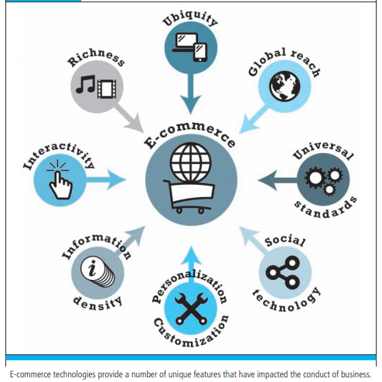
FEATURES OF E-COMMERCE TECHNOLOGY

Slide 10
FEATURES OF E-COMMERCE TECHNOLOGY
Ubiquity: In traditional commerce, a marketplace is restricted i.e. we can be in limited physical area to buy or sell. Whereas E-Commerce is ubiquitous meaning that it is available just about everywhere, at all times. It make possible to shop from your desktop, at home, at work or even from your car, using mobile commerce. The result is called a market space - a marketplace extended beyond traditional boundaries and removed from a temporal and geographic location. From a consumer perspective, ubiquity reduces transaction costs – the costs of participating in a market. To transact, it is no longer necessary that you spend time and money traveling to a market

Slide 11
FEATURES OF E-COMMERCE TECHNOLOGY
Global Reach: Unlike traditional commerce, e-commerce technology permits commercial transaction to cross cultural and national boundaries far more conveniently and cost effectively. As a result, the potential market size for e-commerce merchants is roughly equal to the size of the world’s online population
Universal Standards: One strikingly unusual feature of e-commerce technologies is that the technical standards of the Internet, and therefore the technical standards for conducting e-commerce, are universal standards – they are shared by all nation around the world. In contrast, most traditional commerce technologies differ from one nation to the next. For instance, television and radio standards differ around the world, as doe’s cell telephone technology. The universal technical standards of e-commerce greatly lower market entry cost –t he cost merchants must pay just to bring their goods to market

Slide 12
FEATURES OF E-COMMERCE TECHNOLOGY
Richness: With the use of e-commerce technology merchant can present their message in effective way. Information richness refers to the complexity and content of the message
Interactivity: E-Commerce technologies are interactive, meaning they allow two-way communication between merchant and consumer. Television, for instant, cannot ask the viewer any questions, enter into a conversation with a viewer, or request customer information be entered into a form. In contrast, all of these activities are possible on an e-commerce Web site. Interactivity allows an online merchant to engage a consumer in a ways similar to a face-to-face experience, but on a much more massive, global scale

Slide 13
FEATURES OF E-COMMERCE TECHNOLOGY
Information density: The Internet and the Web vastly increase information density – the total amount and quality of the information available to all market participants, consumers and merchants alike. E-commerce technologies reduce information collection, storage, processing and communication costs. At the same time, these technologies increase greatly the accuracy and timeliness of information – making information more useful and important than ever. As a result, information becomes more plentiful, cheaper and of higher quality
Personalization/Customization: E-commerce technologies permit personalization: Merchants can target their marketing message to specific individuals by adjusting the message. The technology also permits customization – changing the delivered product or service based on a user’s preference or prior behavior

Slide 14
FEATURES OF E-COMMERCE TECHNOLOGY
Social Technology: User Content Generation and Social Networking In a way quite different from all previous technologies, e-commerce technologies have evolved to be much more social by allowing users to create and share content with a worldwide community

Slide 15
WEB 2.0: PLAY MY VERSION
Many of the unique features of e-commerce technology and the Internet come together in a set of applications and social media technologies referred to as Web 2.0. The Internet started out as a simple network to support e-mail and file transfers among remote computers. The Web started out as a way to use the Internet to display simple pages and allow the user to navigate among the pages by linking them together electronically
Web 2.0 a set of applications and technologies that allows users to create, edit, and distribute content; share preferences, bookmarks, and online personas; participate in virtual lives; and build online communities

Slide 16
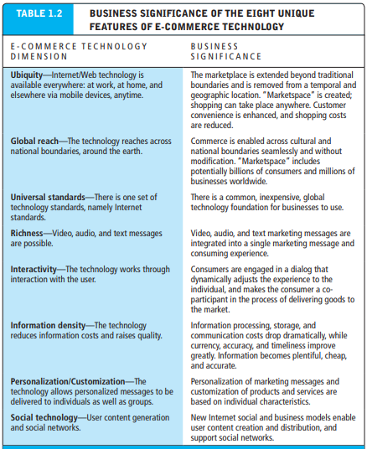
BUSINESS SIGNIFICANCE OF FEATURES

Slide 17
TYPES OF E-COMMERCE
There are several different types of e-commerce and many different ways to characterize them. For the most part, different types of e-commerce are distinguished by the nature of the market relationship—who is selling to whom. Social, mobile, and local e-commerce can be looked at as subsets of these types of e-commerce
Major Types of E-Commerce
Business-to-Consumer (B2C)
Business-to-Business (B2B)
Consumer-to-Consumer (C2C)
Social E-commerce
Mobile E-commerce
Local E-commerce

Slide 18
TYPES OF E-COMMERCE
Business-to-Consumer (B2C)
The most commonly discussed type of e-commerce is business-to-consumer (B2C) e-commerce, in which online businesses attempt to reach individual consumers. B2C commerce includes purchases of retail goods, travel services, and online content. Even though B2C is comparatively small (about $419 billion in 2013 in the United States) it has grown exponentially since 1995, and is the type of e-commerce that most consumers are likely to encounter
Business-to-Business (B2B)
Business-to-business (B2B) e-commerce, in which businesses focus on selling to other businesses, is the largest form of e-commerce, with about $4.7 trillion in transactions in the United States in 2013
Consumer-to-Consumer (C2C)
Consumer-to-consumer (C2C) e-commerce provides a way for consumers to sell to each other, with the help of an online market maker such as eBay or Etsy, or the classifieds site Craigslist

Slide 19
TYPES OF E-COMMERCE
Social E-commerce
Social e-commerce is e-commerce that is enabled by social networks and online social relationships. It is sometimes also referred to as Facebook commerce, but in actuality is a much larger phenomenon that extends beyond just Facebook. The growth of social e-commerce is being driven by a number of factors, including the increasing popularity of social sign-on (signing onto Web sites using your Facebook or other social network ID), network notification (the sharing of approval or disapproval of products, services, and content via Facebook’s Like button or Twitter tweets), online collaborative shopping tools, and social search (recommendations from online trusted friends)
Mobile E-commerce
Mobile e-commerce, or m-commerce, refers to the use of mobile devices to enable online transactions. M-commerce involves the use of cellular and wireless networks to connect laptops, smartphones such as the iPhone, Android, and BlackBerry, and tablet computers such as the iPad to the Internet. Once connected, mobile consumers can conduct transactions, including stock trades, in-store price comparisons, banking, travel reservations, and more

Slide 20
TYPES OF E-COMMERCE
Local E-Commerce
Local e-commerce, as its name suggests, is a form of e-commerce that is focused on engaging the consumer based on his or her current geographic location. Local merchants use a variety of online marketing techniques to drive consumers to their stores. Local e-commerce is the third prong of the social, mobile, local e-commerce wave

Slide 21
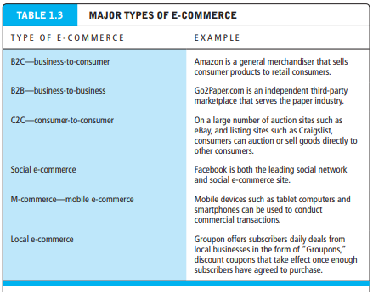
TYPES OF E-COMMERCE

Slide 22
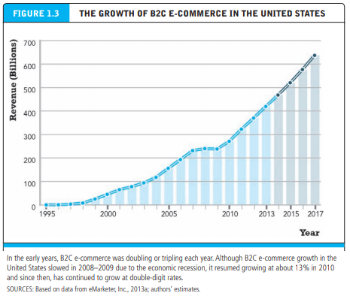
TYPES OF E-COMMERCE

Slide 23
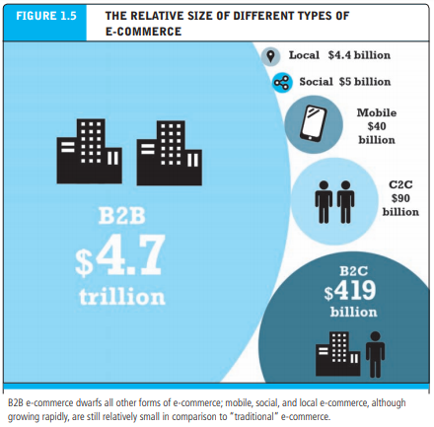
TYPES OF E-COMMERCE

Slide 24
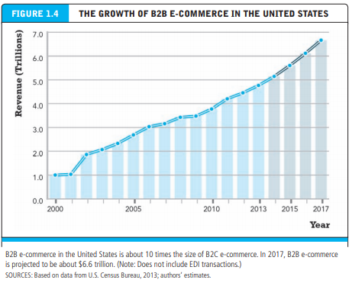
TYPES OF E-COMMERCE

Slide 25
EVOLUTION OF E-COMMERCE
E-commerce has gone through three stages: innovation, consolidation, and reinvention. The early years of e-commerce were a period of explosive growth, beginning in 1995 with the first widespread use of the Web to advertise products and ending in 2000 with the collapse in stock market valuations for dot-com ventures
The early years of e-commerce were a technological success, with the digital infrastructure created during the period solid enough to sustain significant growth in e-commerce during the next decade, and a mixed business success, with significant revenue growth and customer usage, but low profit margins.
E-commerce during its early years did not fulfill economists’ visions of perfect friction-free commerce, or fulfill the visions of entrepreneurs and venture capitalists for first-mover advantages, low customer acquisition and retention costs, and low costs of doing business.

Slide 26
EVOLUTION OF E-COMMERCE
E-commerce entered a period of consolidation beginning in 2001 and extending into 2006.
E-commerce entered a period of reinvention in 2007 with the emergence of the mobile digital platform, social networks, and Web 2.0 applications that attracted huge audiences in a very short time span

Slide 27
EVOLUTION OF E-COMMERCE
E-COMMERCE 1995–2000 : INVENTION
The early years of e-commerce were a period of explosive growth and extraordinary innovation, beginning in 1995 with the first widespread use of the Web to advertise products.
E-commerce meant selling retail goods, usually quite simple goods, on the Internet.
Not enough bandwidth for more complex products.
Marketing was limited to unsophisticated static display ads and not very powerful search engines.
The Web policy of most large firms, if they had one at all, was to have a basic static Web site depicting their brands.
The rapid growth in e-commerce was fueled by over $125 billion in venture capital. This period of e-commerce came to a close in 2000 when stock market valuations plunged, with thousands of companies disappearing (the “dot-com crash”)

Slide 28
EVOLUTION OF E-COMMERCE
E-COMMERCE 2001–2006: CONSOLIDATION
In the second period of e-commerce, from 2000 to 2006, a sobering period of reassessment of e-commerce occurred, with many critics doubting its long-term prospects. Emphasis shifted to a more “business-driven” approach rather than being technology driven; large traditional firms learned how to use the Web to strengthen their market positions; brand extension and strengthening became more important than creating new brands; financing shrunk as capital markets shunned start-up firms; and traditional bank financing based on profitability returned.
E-commerce changed to include not just retail products but also more complex services such as travel and financial services

Slide 29
EVOLUTION OF E-COMMERCE
E-COMMERCE 2007—PRESENT: REINVENTION
Beginning in 2007 with the introduction of the iPhone, to the present day, e-commerce has been transformed yet again by the rapid growth of online social networks, widespread adoption of consumer mobile devices such as smartphones and tablet computers, and the expansion of e-commerce to include local goods and services.
The defining characteristics of this period are often characterized as the “social, mobile, local” online world. In this period, entertainment content begins to develop as a major source of e-commerce revenues and mobile devices become entertainment centers, as well as on-the-go shopping devices for retail goods and services.
Marketing is transformed by the increasing use of social networks, word-of-mouth, viral marketing, and much more powerful data repositories and analytic tools for truly personal marketing

Slide 30
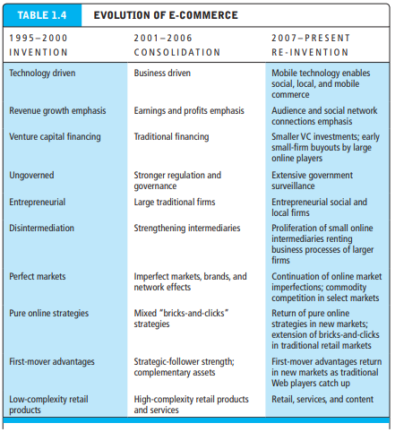
EVOLUTION OF E-COMMERCE

Slide 31
FACTORS DEFINING FUTURE OF E-COMMERCE
Given that e-commerce has changed greatly in the last several years, its future cannot be predicted except to say “Watch for more surprises.”
Factors that will define the future of e-commerce include the following:
E-commerce technology (the Internet, the Web, and the mobile platform) will continue to propagate through all commercial activity, with overall revenues from e-commerce and the number of products and services sold all rising.

Slide 32
FACTORS DEFINING FUTURE OF E-COMMERCE
Traditional well-endowed and experienced Fortune 500 companies will continue to play a dominant role.
The number of successful purely online companies will continue to decline, and most successful e-commerce firms will adopt an integrated, multi-channel bricks-and-clicks strategy.
Regulation of the Internet and e-commerce by government will grow both in the United States and worldwide.

Slide 33
E-COMMERCE ORGANIZING THEMES
Understanding e-commerce in its totality is a difficult task because there are so many facets to the phenomenon. Technologies develop first, and then those developments are exploited commercially. Once commercial exploitation of the technology becomes widespread, a host of social, cultural, and political issues arise
E-commerce involves three broad interrelated themes:
Technology—To understand e-commerce, we need a basic understanding of the information technologies upon which it is built, including the Internet, the Web, and mobile platform, and a host of complementary technologies—cloud computing, personal computers, smartphones, tablet computers, local area networks, client/server computing, packet-switched communications, protocols such as TCP/IP, Web servers, HTML, and relational and non-relational databases, among others.

Slide 34
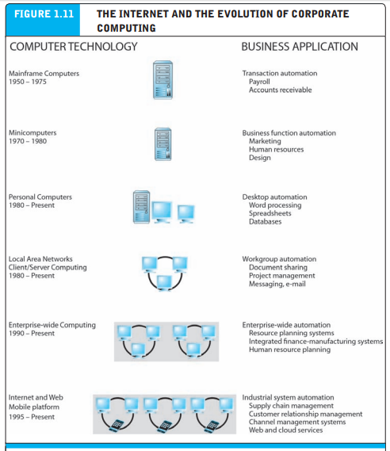
E-COMMERCE ORGANIZING THEMES

Slide 35
E-COMMERCE ORGANIZING THEMES
Business — While technology provides the infrastructure, it is the business applications—the potential for extraordinary returns on investment—that create the interest and excitement in e-commerce. Therefore, you also need to understand some key business concepts such as electronic markets, information goods, business models, firm and industry value chains, industry structure, and consumer behavior in digital markets

Slide 36
E-COMMERCE ORGANIZING THEMES
Society—Understanding the pressures that global e-commerce places on contemporary society is critical to being successful in the e-commerce marketplace. The primary societal issues are intellectual property, individual privacy, and public policy

Slide 37
ACADEMIC DISCIPLINES CONCERNED WITH E-COMMERCE
The phenomenon of e-commerce is so broad that a multidisciplinary perspective is required. There are two primary approaches to e-commerce: technical and behavioral
Technical Side:
Computer scientists are interested in e-commerce as an exemplary application of Internet technology. They are concerned with the development of computer hardware, software, and telecommunications systems, as well as standards, encryption, and database design and operation
Management scientists are primarily interested in building mathematical models of business processes and optimizing them to learn how businesses can exploit the Internet to improve their business operations.

Slide 38
ACADEMIC DISCIPLINES CONCERNED WITH E-COMMERCE
Information systems professionals are interested in e-commerce because of its implications for firm and industry value chains, industry structure, and corporate strategy.
Economists have focused on online consumer behavior and on the features of digital electronic markets.
Behavioral Side:
Sociologists have focused on studies of Internet usage, the role of social inequality in skewing Internet benefits, and the use of the Web as a personal and group communications tool.
Finance and accounting scholars have focused on e-commerce firm valuation and accounting practices.

Slide 39
ACADEMIC DISCIPLINES CONCERNED WITH E-COMMERCE
Management scholars have focused on entrepreneurial behavior and the challenges faced by young firms that are required to develop organizational structures in short time spans.
Marketing scholars have focused on consumer response to online marketing and advertising campaigns, and the ability of firms to brand, segment markets, target audiences, and position products to achieve higher returns on investment

Slide 40
HOW E-COMMERCE CHANGES BUSINESS: STRATEGY,STRUCTURE, AND PROCESS
E-commerce has had a major impact on the business environment in the last decade, and have affected:
Industry structure—the nature of players in an industry and their relative bargaining power by changing the basis of competition among rivals, the barriers to entry, the threat of new substitute products, the strength of suppliers, and the bargaining power of buyers.
Industry value chains—the set of activities performed in an industry by suppliers, manufacturers, transporters, distributors, and retailers that transforms raw inputs into final products and services by reducing the cost of information and other transaction costs.

Slide 41
HOW E-COMMERCE CHANGES BUSINESS: STRATEGY,STRUCTURE, AND PROCESS
Firm value chains—the set of activities performed within an individual firm to create final products from raw inputs by increasing operational efficiency.
Business strategy—a set of plans for achieving superior long-term returns on the capital invested in a firm by offering unique ways to differentiate products, obtain cost advantages, compete globally, or compete in a narrow market or product segment

Slide 42
PROJECTS
Search the Web for an example of each of the major types of e-commerce described in Slides 18 - 25 : Types of E-Commerce . Create an electronic slide presentation describing each Web site (take a screenshot of each, if possible), and explain why it fits into the category of e-commerce to which you have assigned it.
Choose an e-commerce Web site and assess it in terms of the eight unique features of e-commerce technology described in Slides 10 - 17 : Features of E-Commerce Technology. Which of the features does the site implement well, and which features poorly, in your opinion? Prepare a electronic slide presentation for the website you have chosen detailing your findings and any suggestions for improvement you may have.
Given the development and history of e-commerce in the years from 1995–2017 as described in Slides 26 – 37 : Evolution of E-Commerce, what do you predict we will see during the next five years of e-commerce? Describe some of the technological, business, and societal shifts that may occur as the Internet continues to grow and expand. Prepare a brief electronic slide presentation or written report to explain your vision of what e-commerce will look like in 2022.

Slide 43
PROJECTS
Define “social e-commerce” and describe why it is a new form of advertising, search, and commerce
Locate where cookies are stored on your computer. (They are probably in a folder entitled “Cookies” within your browser program.) List the top 10 cookies you find and write a brief report describing the kinds of sites that placed the cookies. What purpose do you think the cookies serve? Also, what do you believe are the major advantages and disadvantages of cookies? In your opinion, do the advantages outweigh the disadvantages, or vice versa?

Slide 44
UNIT I FUNDAMENTALS OF E-COMMERCE
CHAPTER 2 : E-COMMERCE BUSINESS MODELS AND CONCEPTS

Slide 45
INTRODUCTION TO BUSINESS MODEL
A business model is a set of planned activities (sometimes referred to as business processes) designed to result in a profit in a marketplace. A business model is not always the same as a business strategy, although in some cases they are very close insofar as the business model explicitly considers the competitive environment.
The business model is at the center of the business plan. A business plan is a document that describes a firm’s business model. A business plan always considers the competitive environment. An e-commerce business model aims to use and leverage the unique qualities of the Internet, the Web, and the mobile platform.

Slide 46
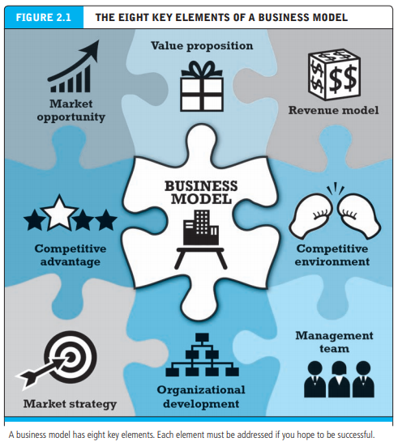
KEY ELEMENTS OF A BUSINESS MODEL

Slide 47
KEY ELEMENTS OF A BUSINESS MODEL
Value Proposition:
A company’s value proposition is at the very heart of its business model. A value proposition defines how a company’s product or service fulfills the needs of customers To develop and/or analyze a firm’s value proposition, you need to understand why customers will choose to do business with the firm instead of another company and what the firm provides that other firms do not and cannot.
Revenue Model:
A firm’s revenue model describes how the firm will earn revenue, generate profits, and produce a superior return on invested capital. We use the terms revenue model and financial model interchangeably

Slide 48
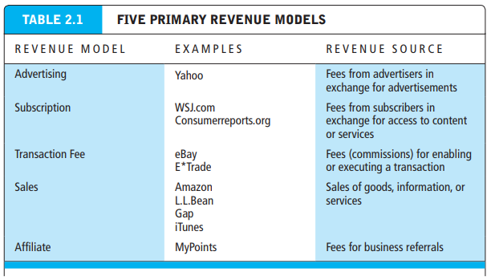
KEY ELEMENTS OF A BUSINESS MODEL

Slide 49
KEY ELEMENTS OF A BUSINESS MODEL
Competitive Environment:
A firm’s competitive environment refers to the other companies selling similar products and operating in the same marketspace. It also refers to the presence of substitute products and potential new entrants to the market, as well as the power of customers and suppliers over your business
Competitive Advantage:
Firms achieve a competitive advantage when they can produce a superior product and/or bring the product to market at a lower price than most, or all, of their competitors (Porter, 1985). Firms also compete on scope. Some firms can develop global markets, while other firms can develop only a national or regional market. Firms that can provide superior products at the lowest cost on a global basis are truly advantaged

Slide 50
KEY ELEMENTS OF A BUSINESS MODEL
Market Strategy: No matter how tremendous a firm’s qualities, its marketing strategy and execution are often just as important. The best business concept, or idea, will fail if it is not properly marketed to potential customers. Everything you do to promote your company’s products and services to potential customers is known as marketing. Market strategy is the plan you put together that details exactly how you intend to enter a new market and attract new customers.
Organizational Development:
Although many entrepreneurial ventures are started by one visionary individual, it is rare that one person alone can grow an idea into a multi-million dollar company. In most cases, fast-growth companies—especially e-commerce businesses—need employees and a set of business procedures
Companies that hope to grow and thrive need to have a plan for organizational development that describes how the company will organize the work that needs to be accomplished

Slide 51
KEY ELEMENTS OF A BUSINESS MODEL
Management Team : Arguably, the single most important element of a business model is the management team responsible for making the model work. A strong management team gives a model instant credibility to outside investors, immediate market-specific knowledge, and experience in implementing business plans. A strong management team may not be able to salvage a weak business model, but the team should be able to change the model and redefine the business as it becomes necessary

Slide 52
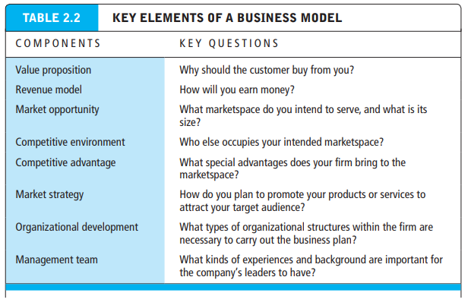
KEY ELEMENTS OF A BUSINESS MODEL

Slide 53
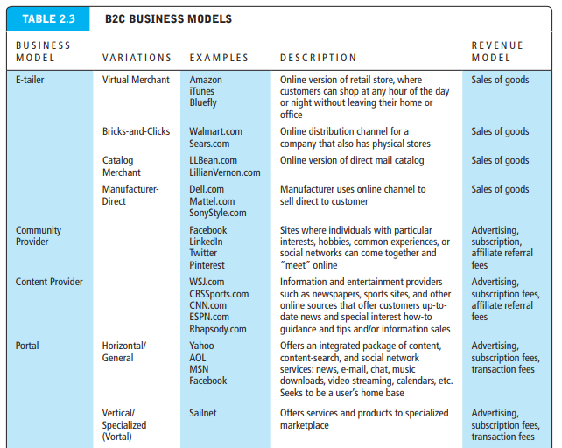
MAJOR BUSINESS TO CONSUMER(B2C) BUSINESS MODELS

Slide 54
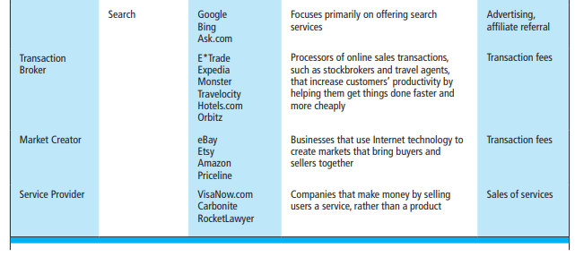
MAJOR BUSINESS TO CONSUMER(B2C) BUSINESS MODELS

Slide 55
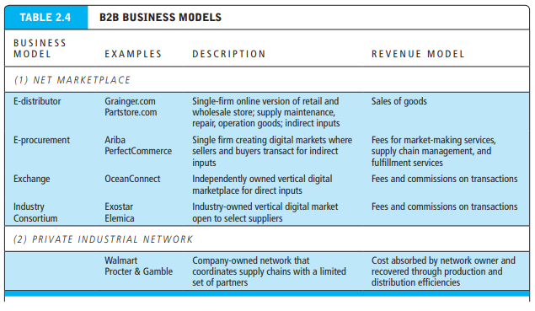
MAJOR BUSINESS TO BUSINESS(B2B) BUSINESS MODELS

Slide 56
HOW E-COMMERCE CHANGES BUSINESS: STRUCTURE, STRATEGY, AND PROCESS
Now that you have a clear grasp of the variety of business models used by e-commerce firms, you also need to understand how e-commerce has changed the business environment in the last decade, including industry structures, business strategies, and industry and firm operations (business processes and value chains).
In general, the Internet is an open standards system available to all players, and this fact inherently makes it easy for new competitors to enter the marketplace and offer substitute products or channels of delivery. The Internet tends to intensify competition. Because information becomes available to everyone, the Internet inherently shifts power to buyers who can quickly discover the lowest-cost provider

Slide 57
INDUSTRY STRUCTURE
E-commerce changes industry structure, in some industries more than others. Industry structure refers to the nature of the players in an industry and their relative bargaining power. An industry’s structure is characterized by five forces: rivalry among existing competitors, the threat of substitute products, barriers to entry into the industry, the bargaining power of suppliers, and the bargaining power of buyers
An industry structural analysis is an effort to understand and describe the nature of competition in an industry, the nature of substitute products, the barriers to entry, and the relative strength of consumers and suppliers

Slide 58
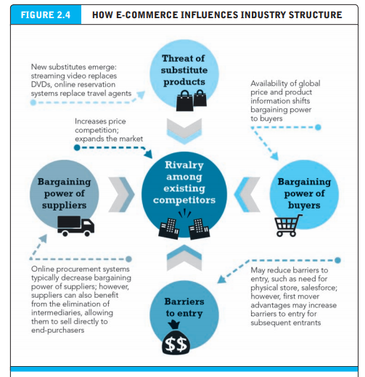
INDUSTRY STRUCTURE

Slide 59
INDUSTRY VALUE CHAINS
While an industry structural analysis helps you understand the impact of e-commerce technology on the overall business environment in an industry, a more detailed industry value chain analysis can help identify more precisely just how e-commerce may change business operations at the industry level. One of the basic tools for understanding the impact of information technology on industry and firm operations is the value chain.
The concept is quite simple. A value chain is the set of activities performed in an industry or in a firm that transforms raw inputs into final products and services.

Slide 60
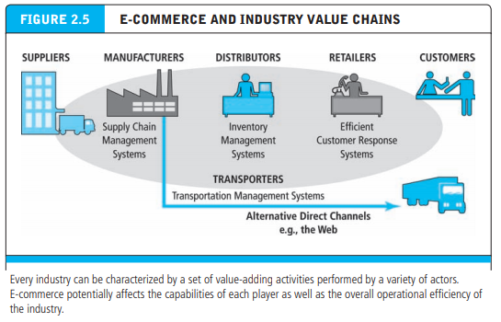
INDUSTRY VALUE CHAINS

Slide 61
FIRM VALUE CHAINS
The concept of value chain can be used to analyze a single firm’s operational efficiency as well. The question here is: How does e-commerce technology potentially affect the value chains of firms within an industry?
A firm value chain is the set of activities a firm engages in to create final products from raw inputs
E-commerce offers firms many opportunities to increase their operational efficiency and differentiate their products

Slide 62
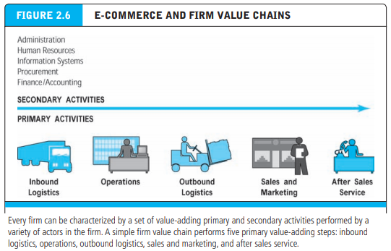
FIRM VALUE CHAINS

Slide 63
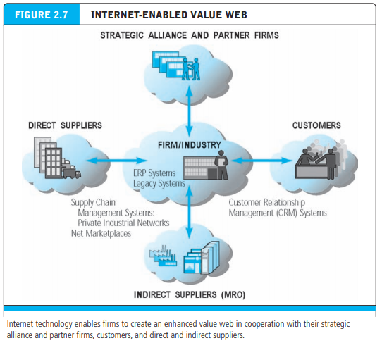
INTERNET ENABLED VALUE WEB

Slide 64
BUSINESS STRATEGY
A business strategy is a set of plans for achieving superior long-term returns on the capital invested in a business firm. A business strategy is therefore a plan for making profits in a competitive environment over the long term.
Profit is simply the difference between the price a firm is able to charge for its products and the cost of producing and distributing goods

Slide 65
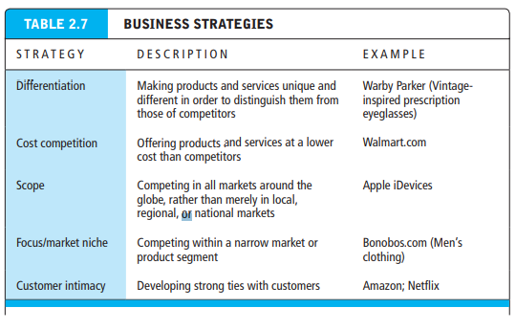
BUSINESS STRATEGY

